Slide 1
404 Demo
Marching Band LPS

Slide 2
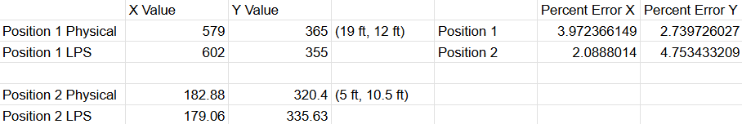
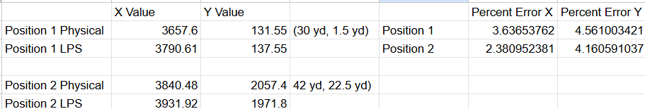
3.2.1.1 Location Precision Validation
Data was taken for two separate tests:
Both tests showed an accuracy of less than 5%
For full scale operation, error is never greater than a meter

Slide 3
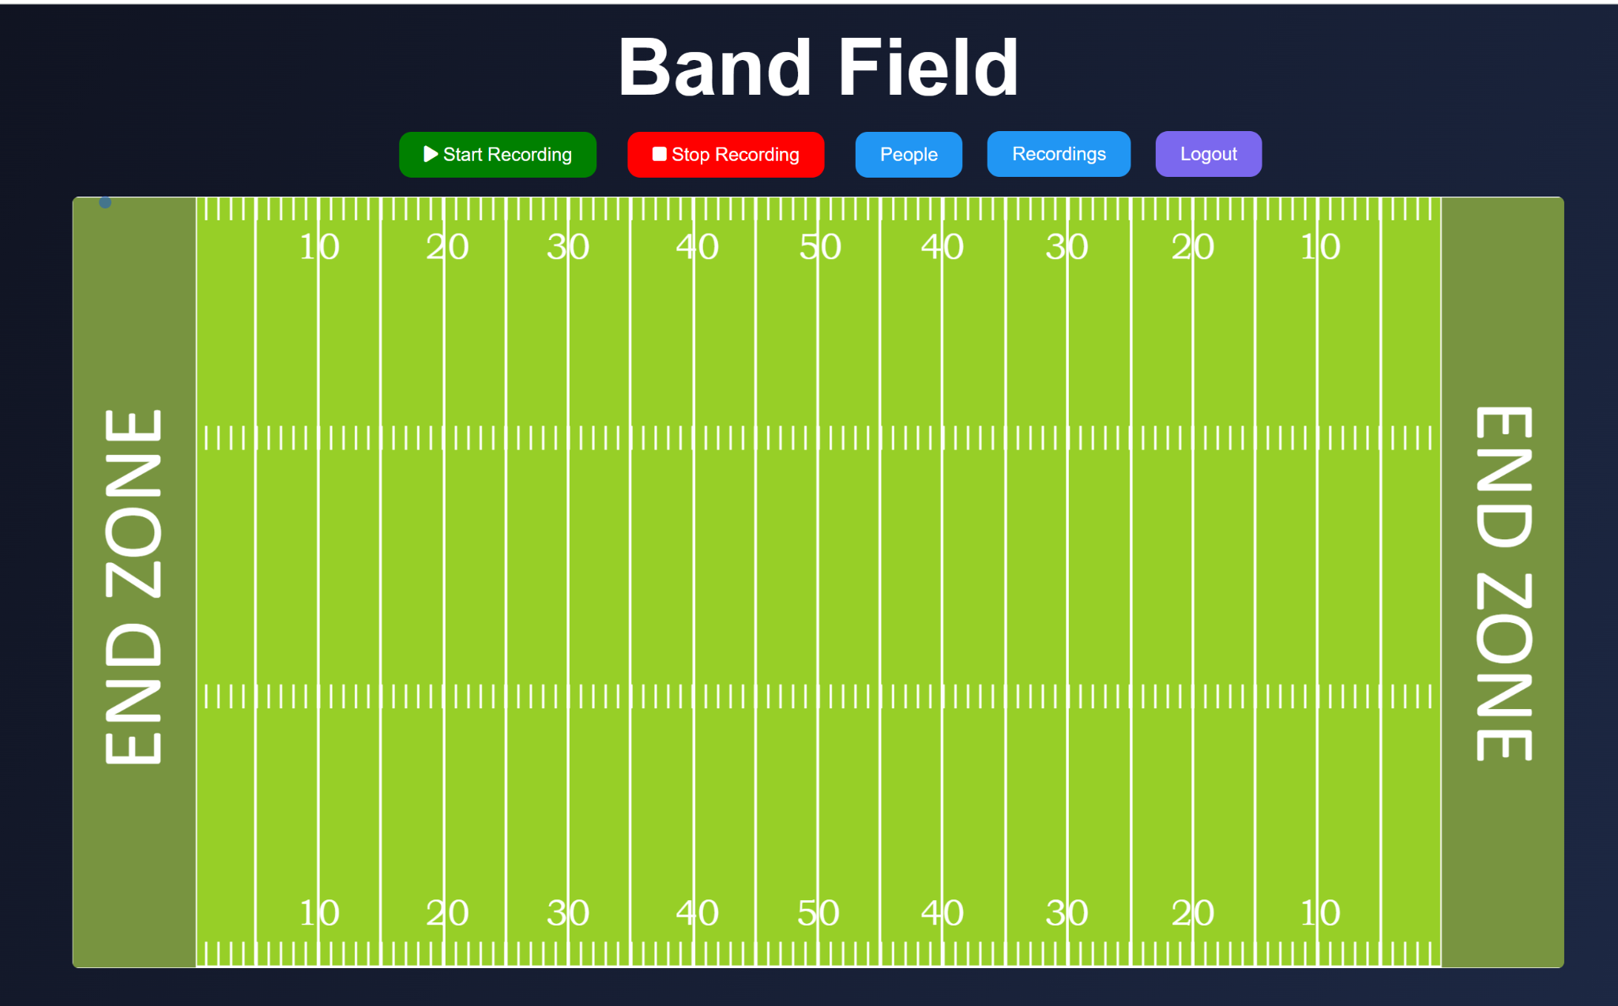
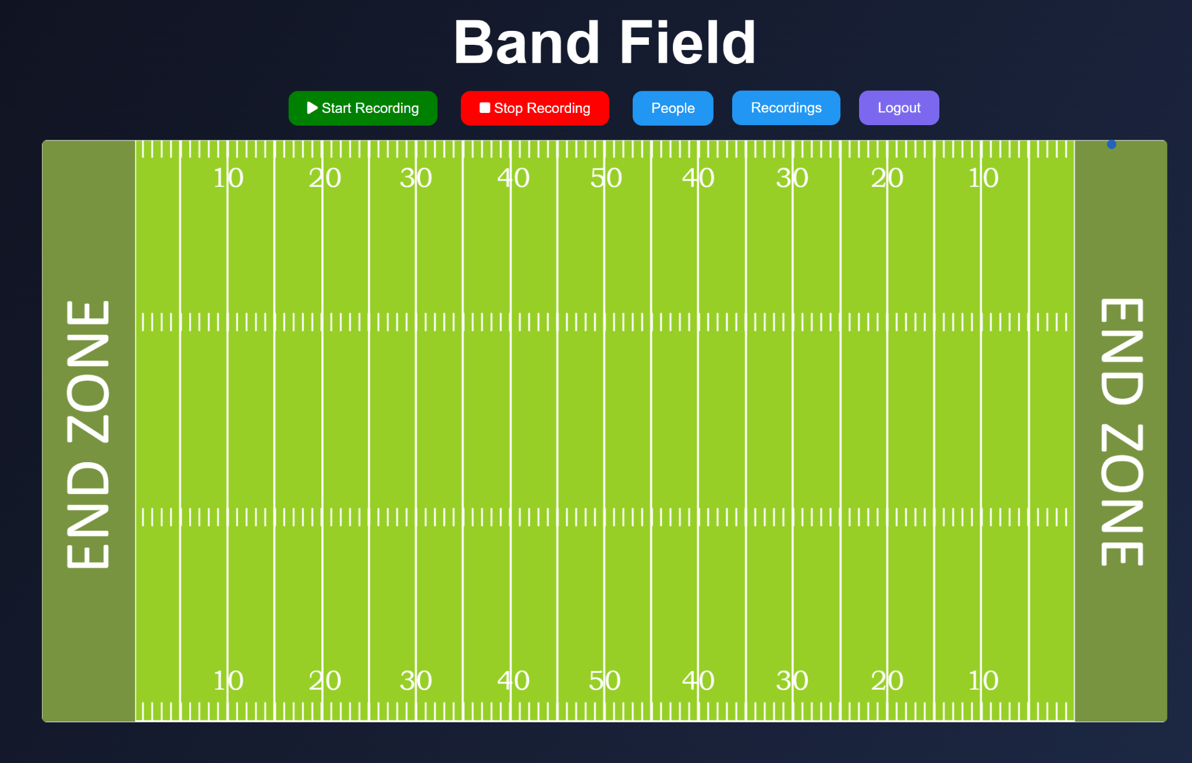
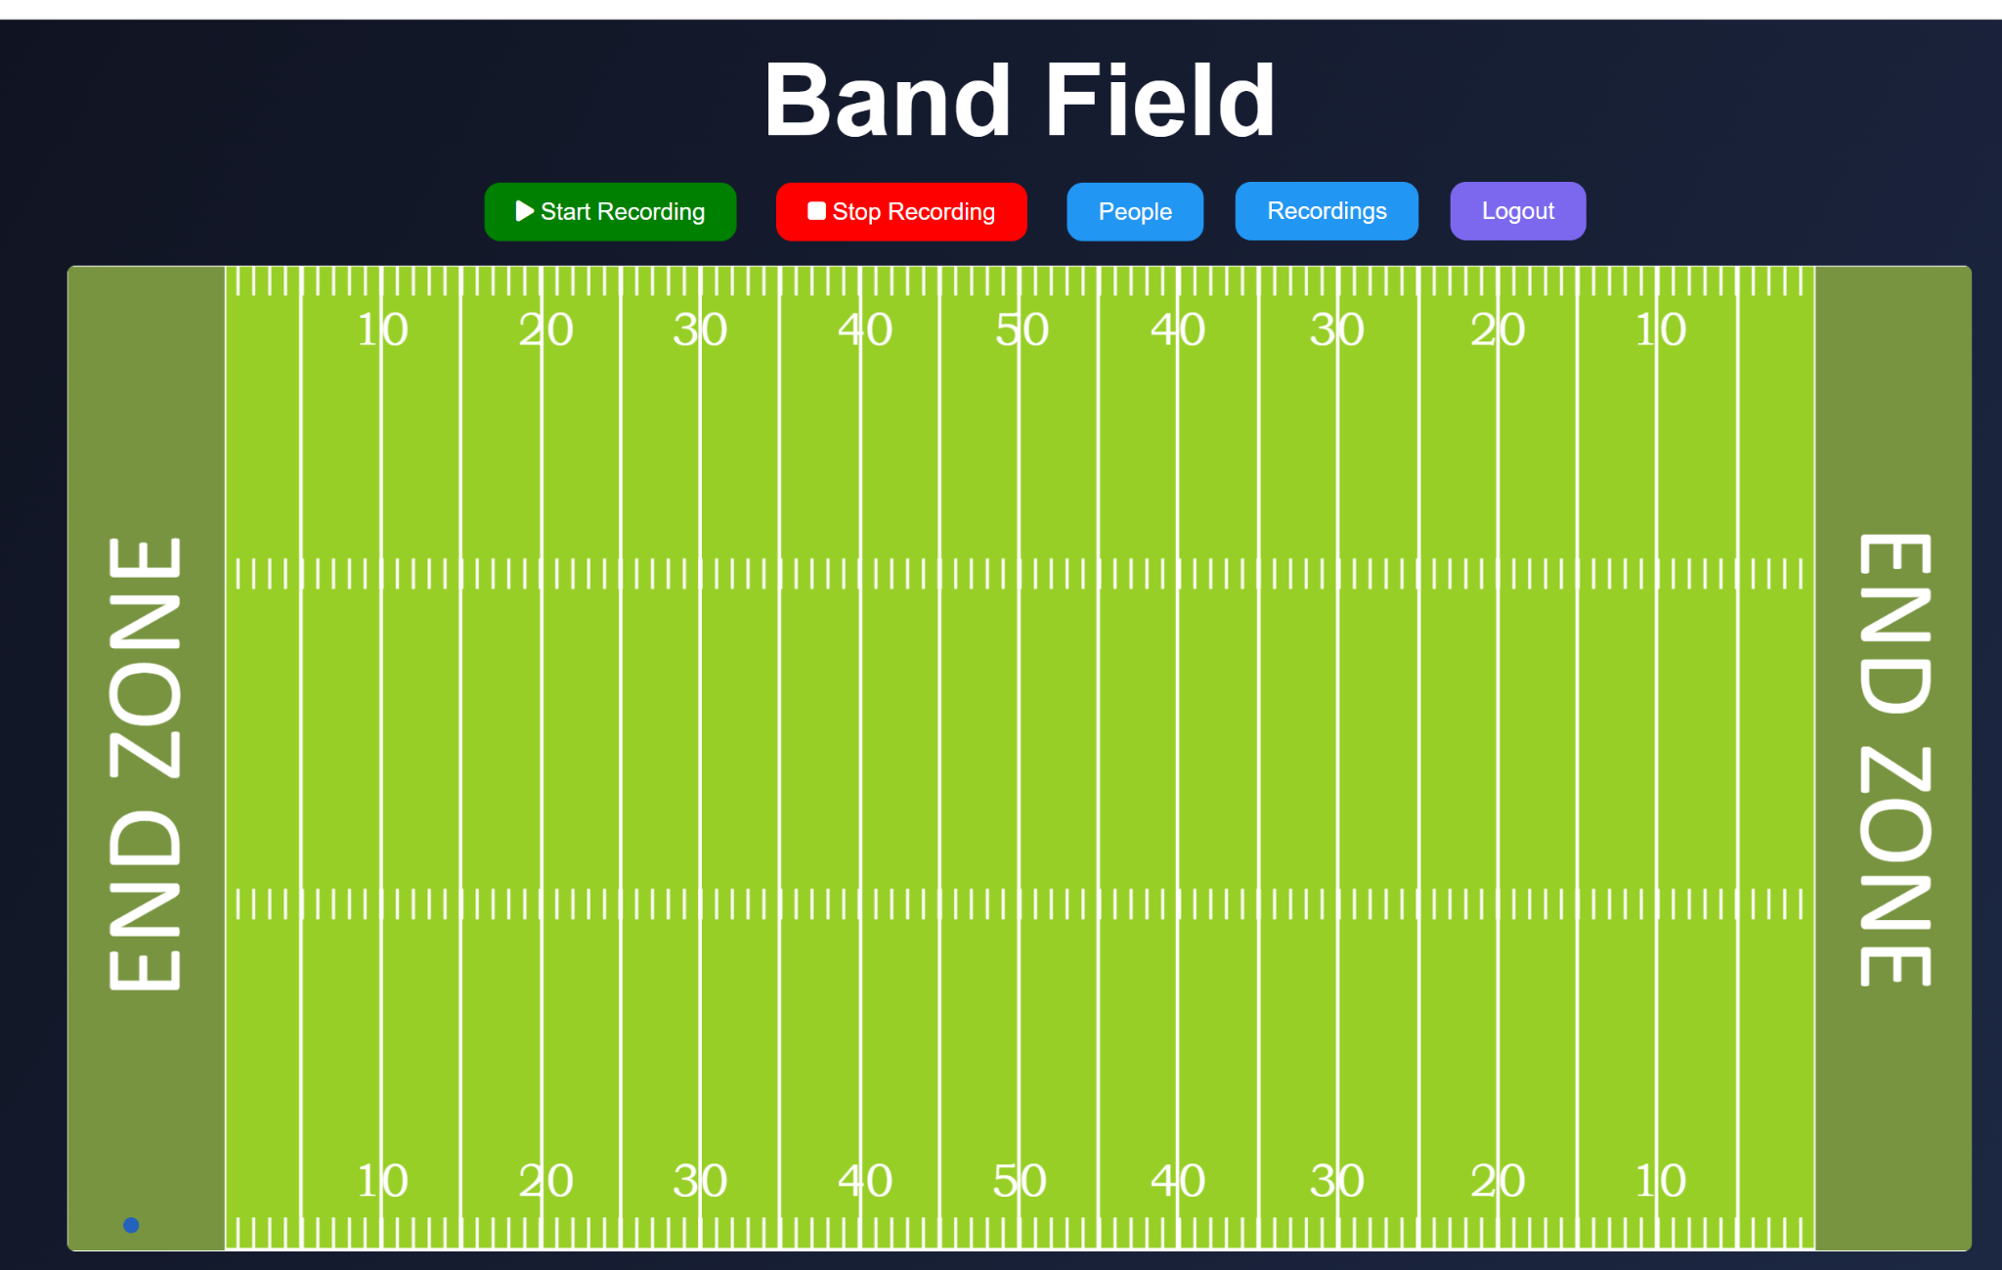
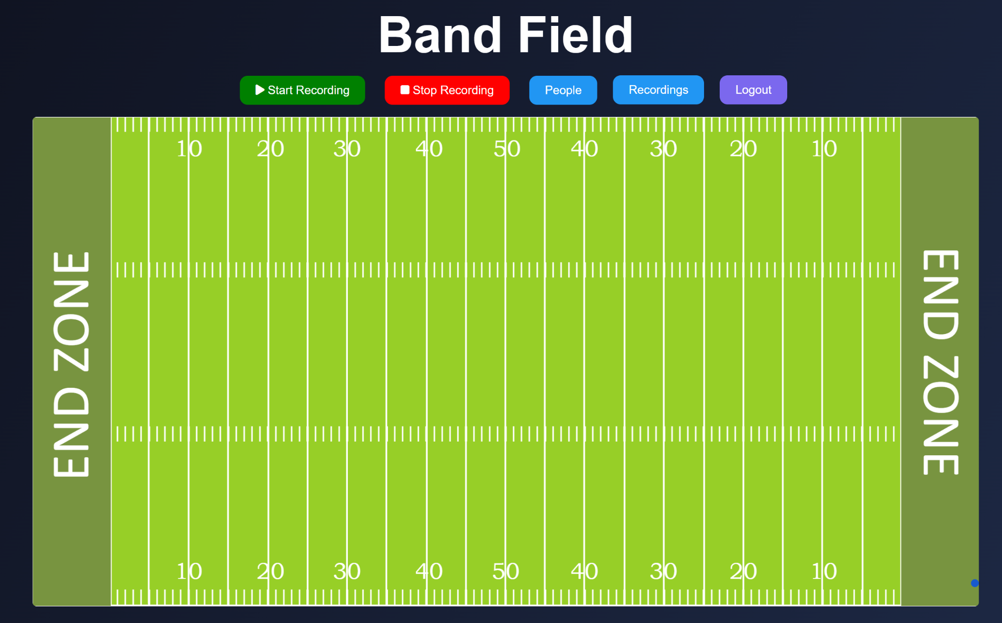
3.2.1.2 Range of Detection Validation
Tag was walked out to every corner of the field and coordinate data was still able to be collected
Tag was able to be detected outside of 100 x 50 m range, going all the way to the end zones

Slide 4
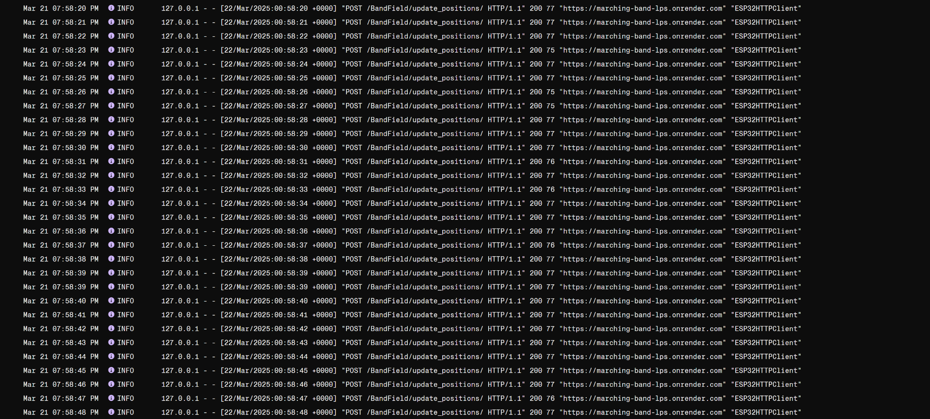
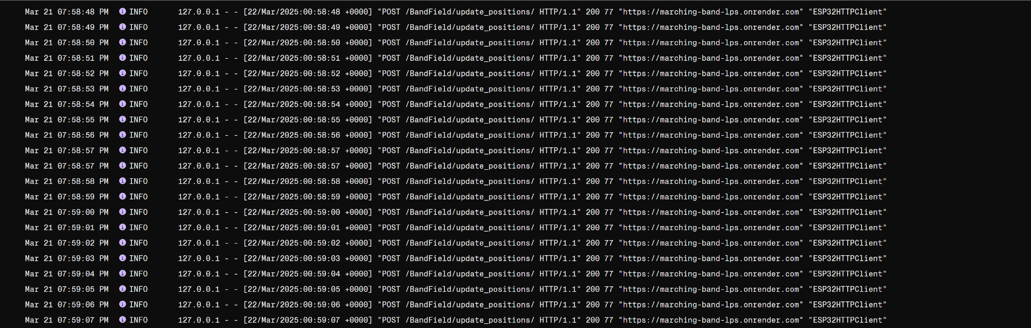
3.2.1.3 Website Data Processing Time Validation
Under a stable and strong WiFi connection, 50 logs were processed in a span of 47 seconds which meets the requirements of 50 logs in 50 seconds

Slide 5
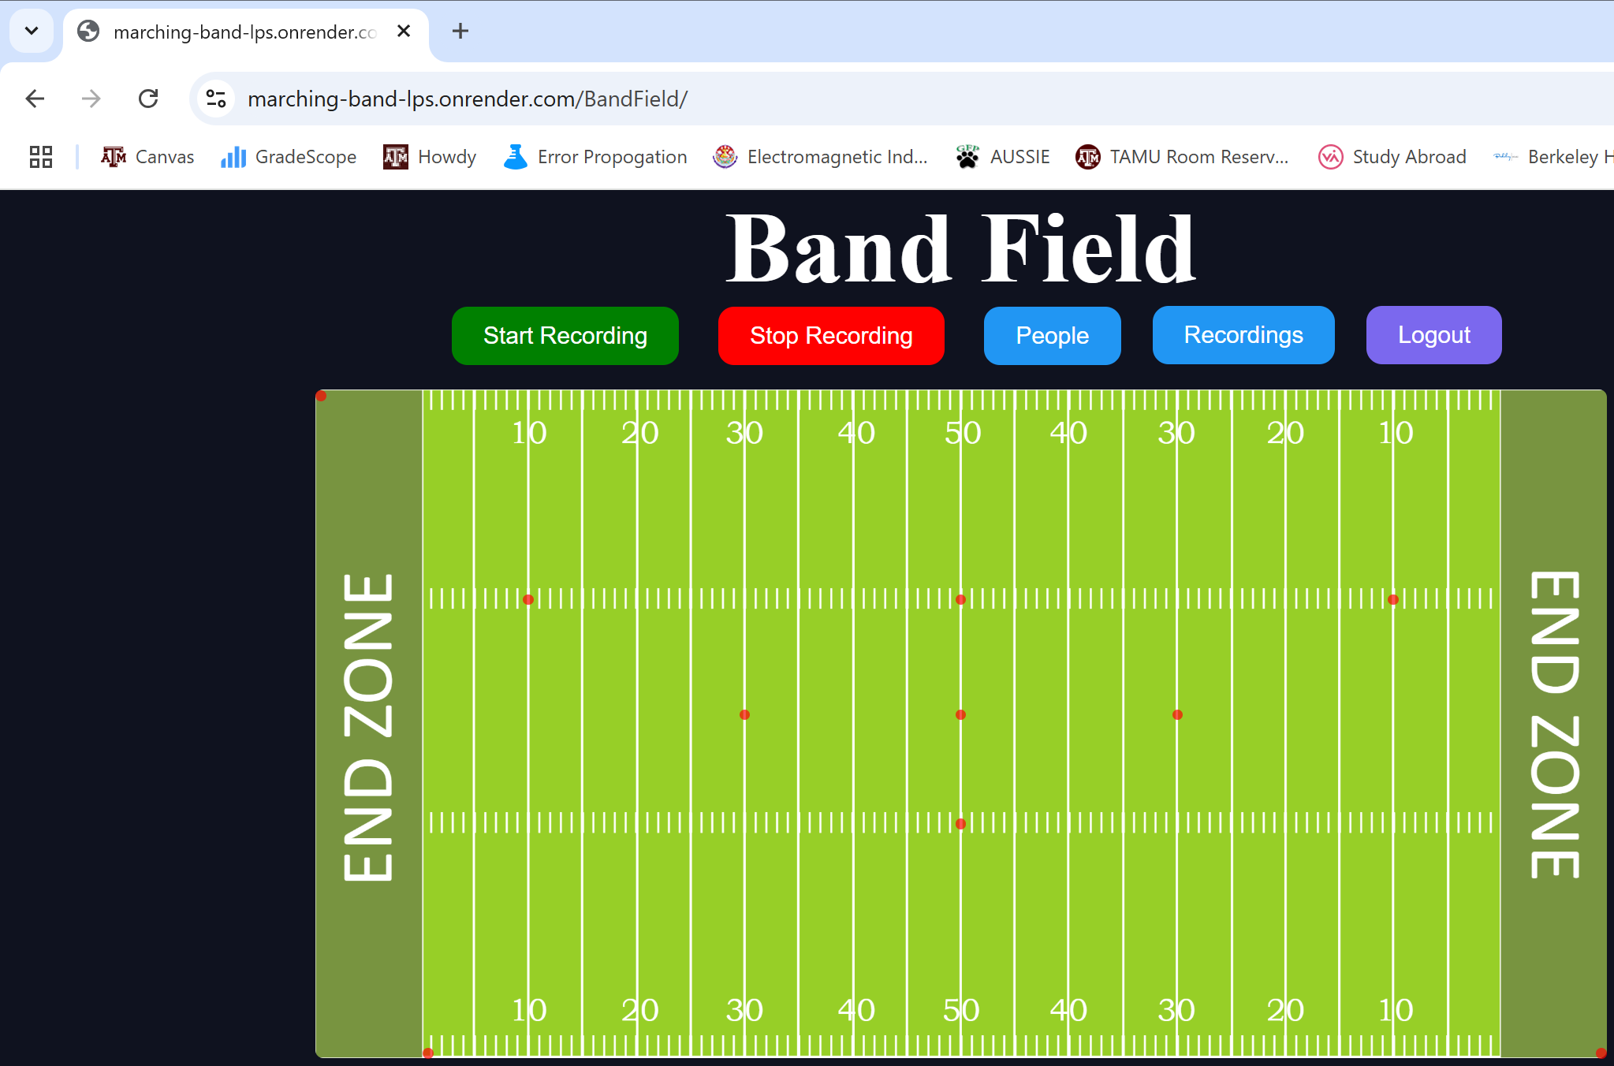
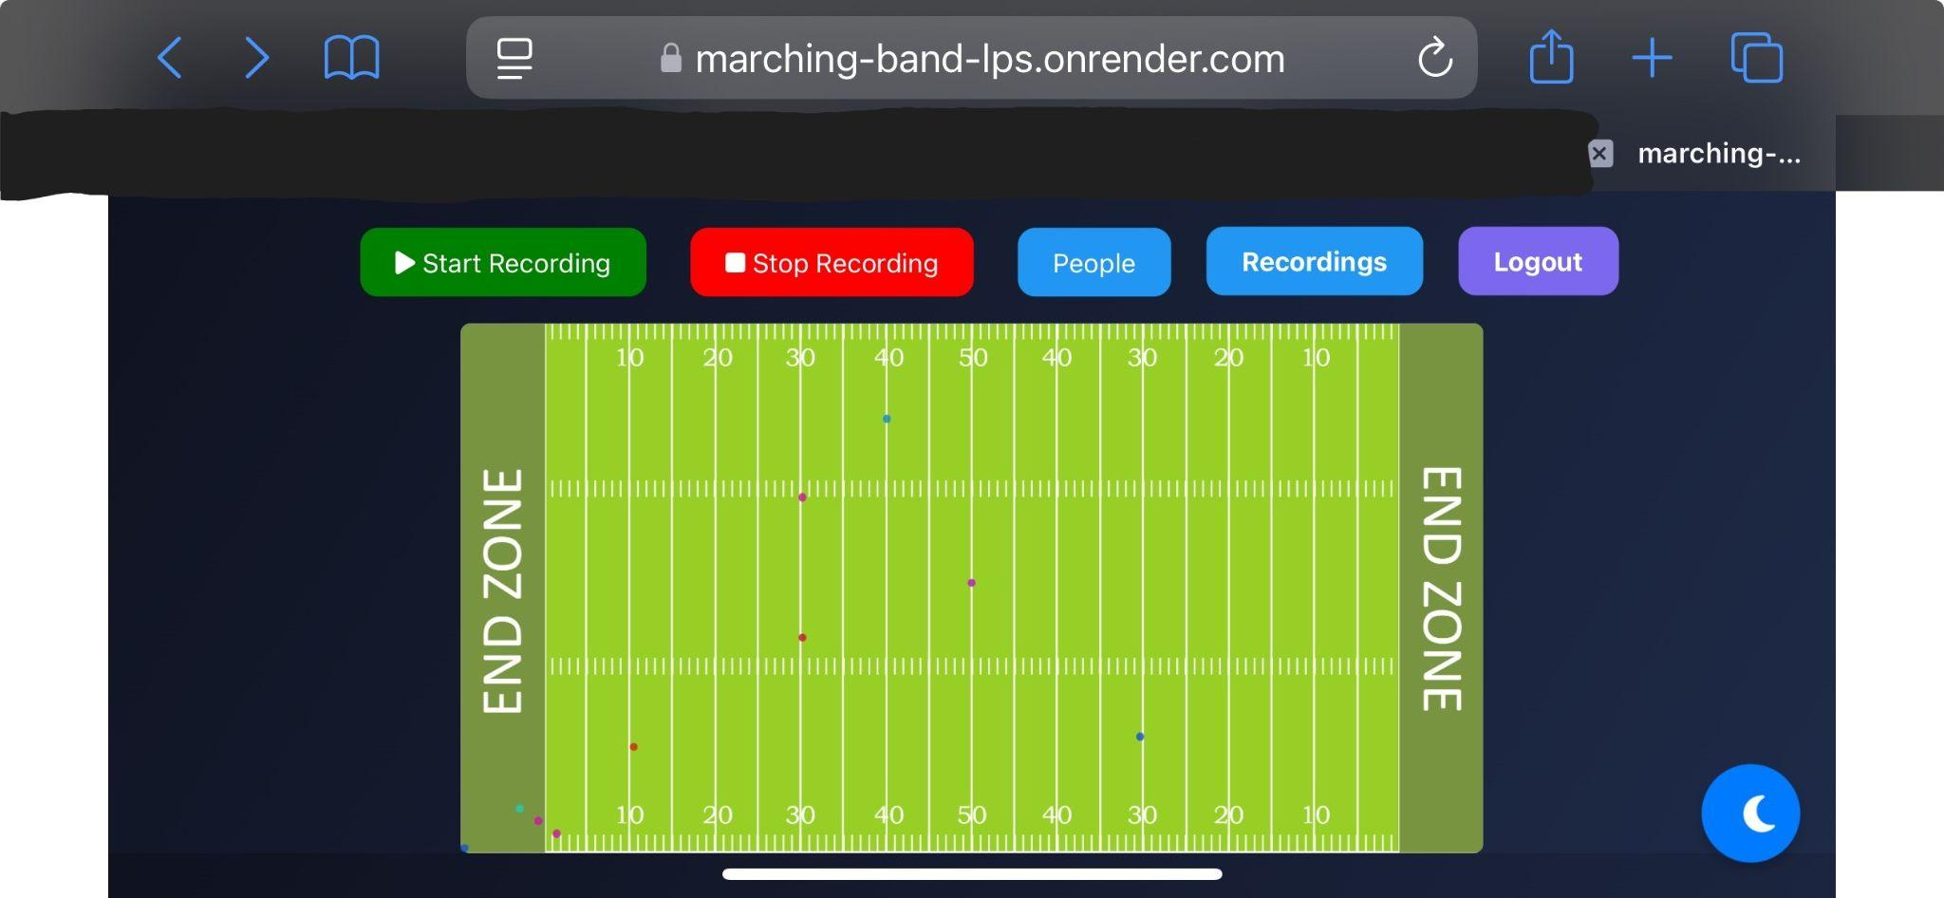
3.2.1.4 Website Connection
Website and corresponding databases were hosted on a hosting site called “Render” to allow any user to access the site and use the functions/tools provided

Slide 6
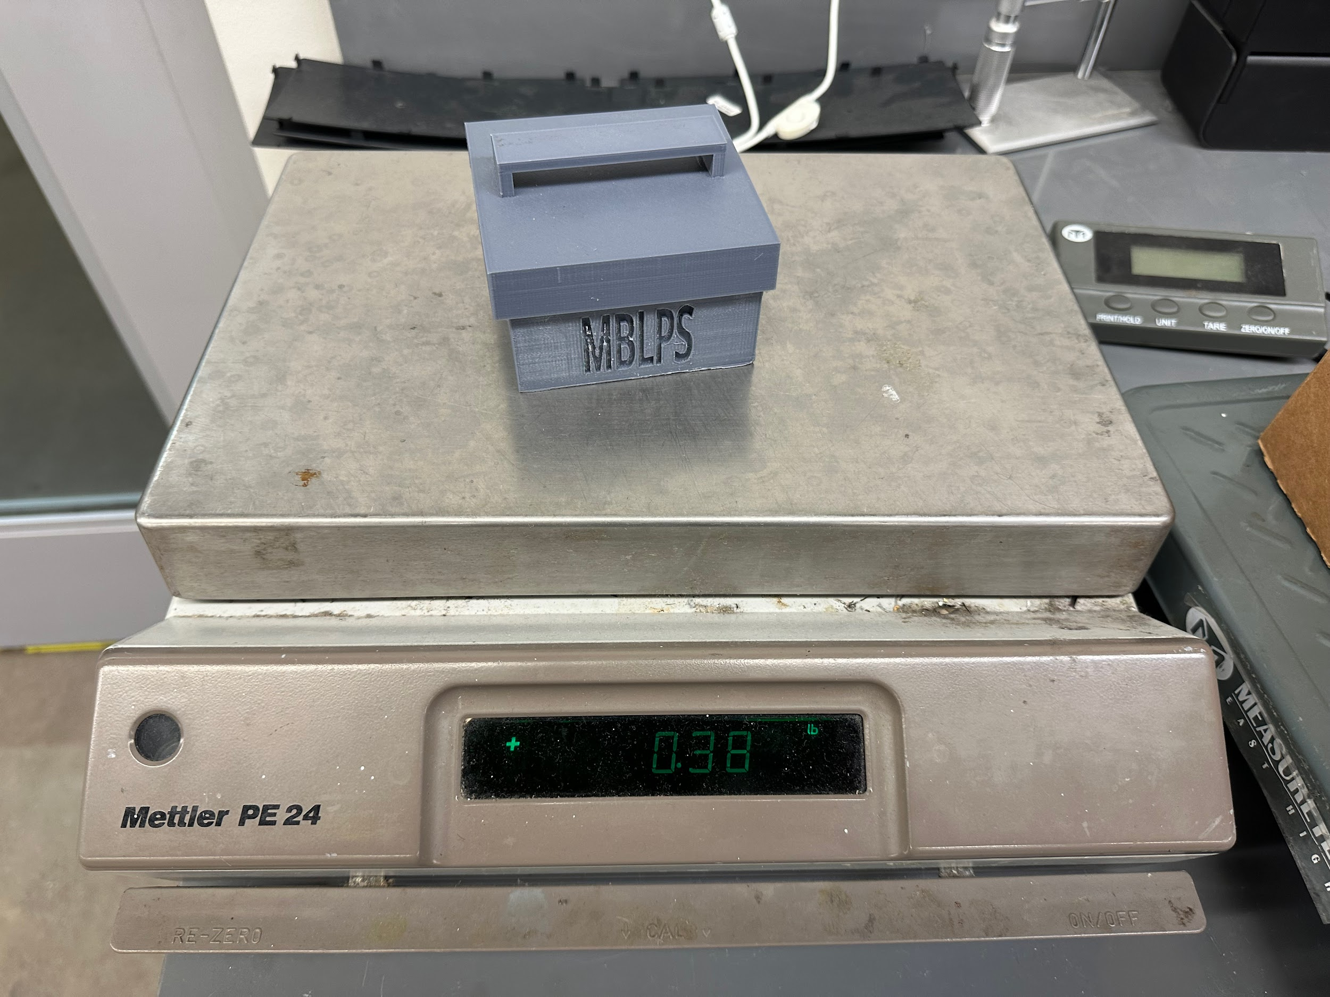
3.2.2.1 Mass Validation
Measurement was taken with the casing, board, and batteries all on scale.
0.38 lb = 0.17 kg, which is well under out 1 kg limit

Slide 7
3.2.2.2 Volume Validation
Casing box was measured to be 80x40x80 mm which was within the criteria of 80x80x160 mm

Slide 8
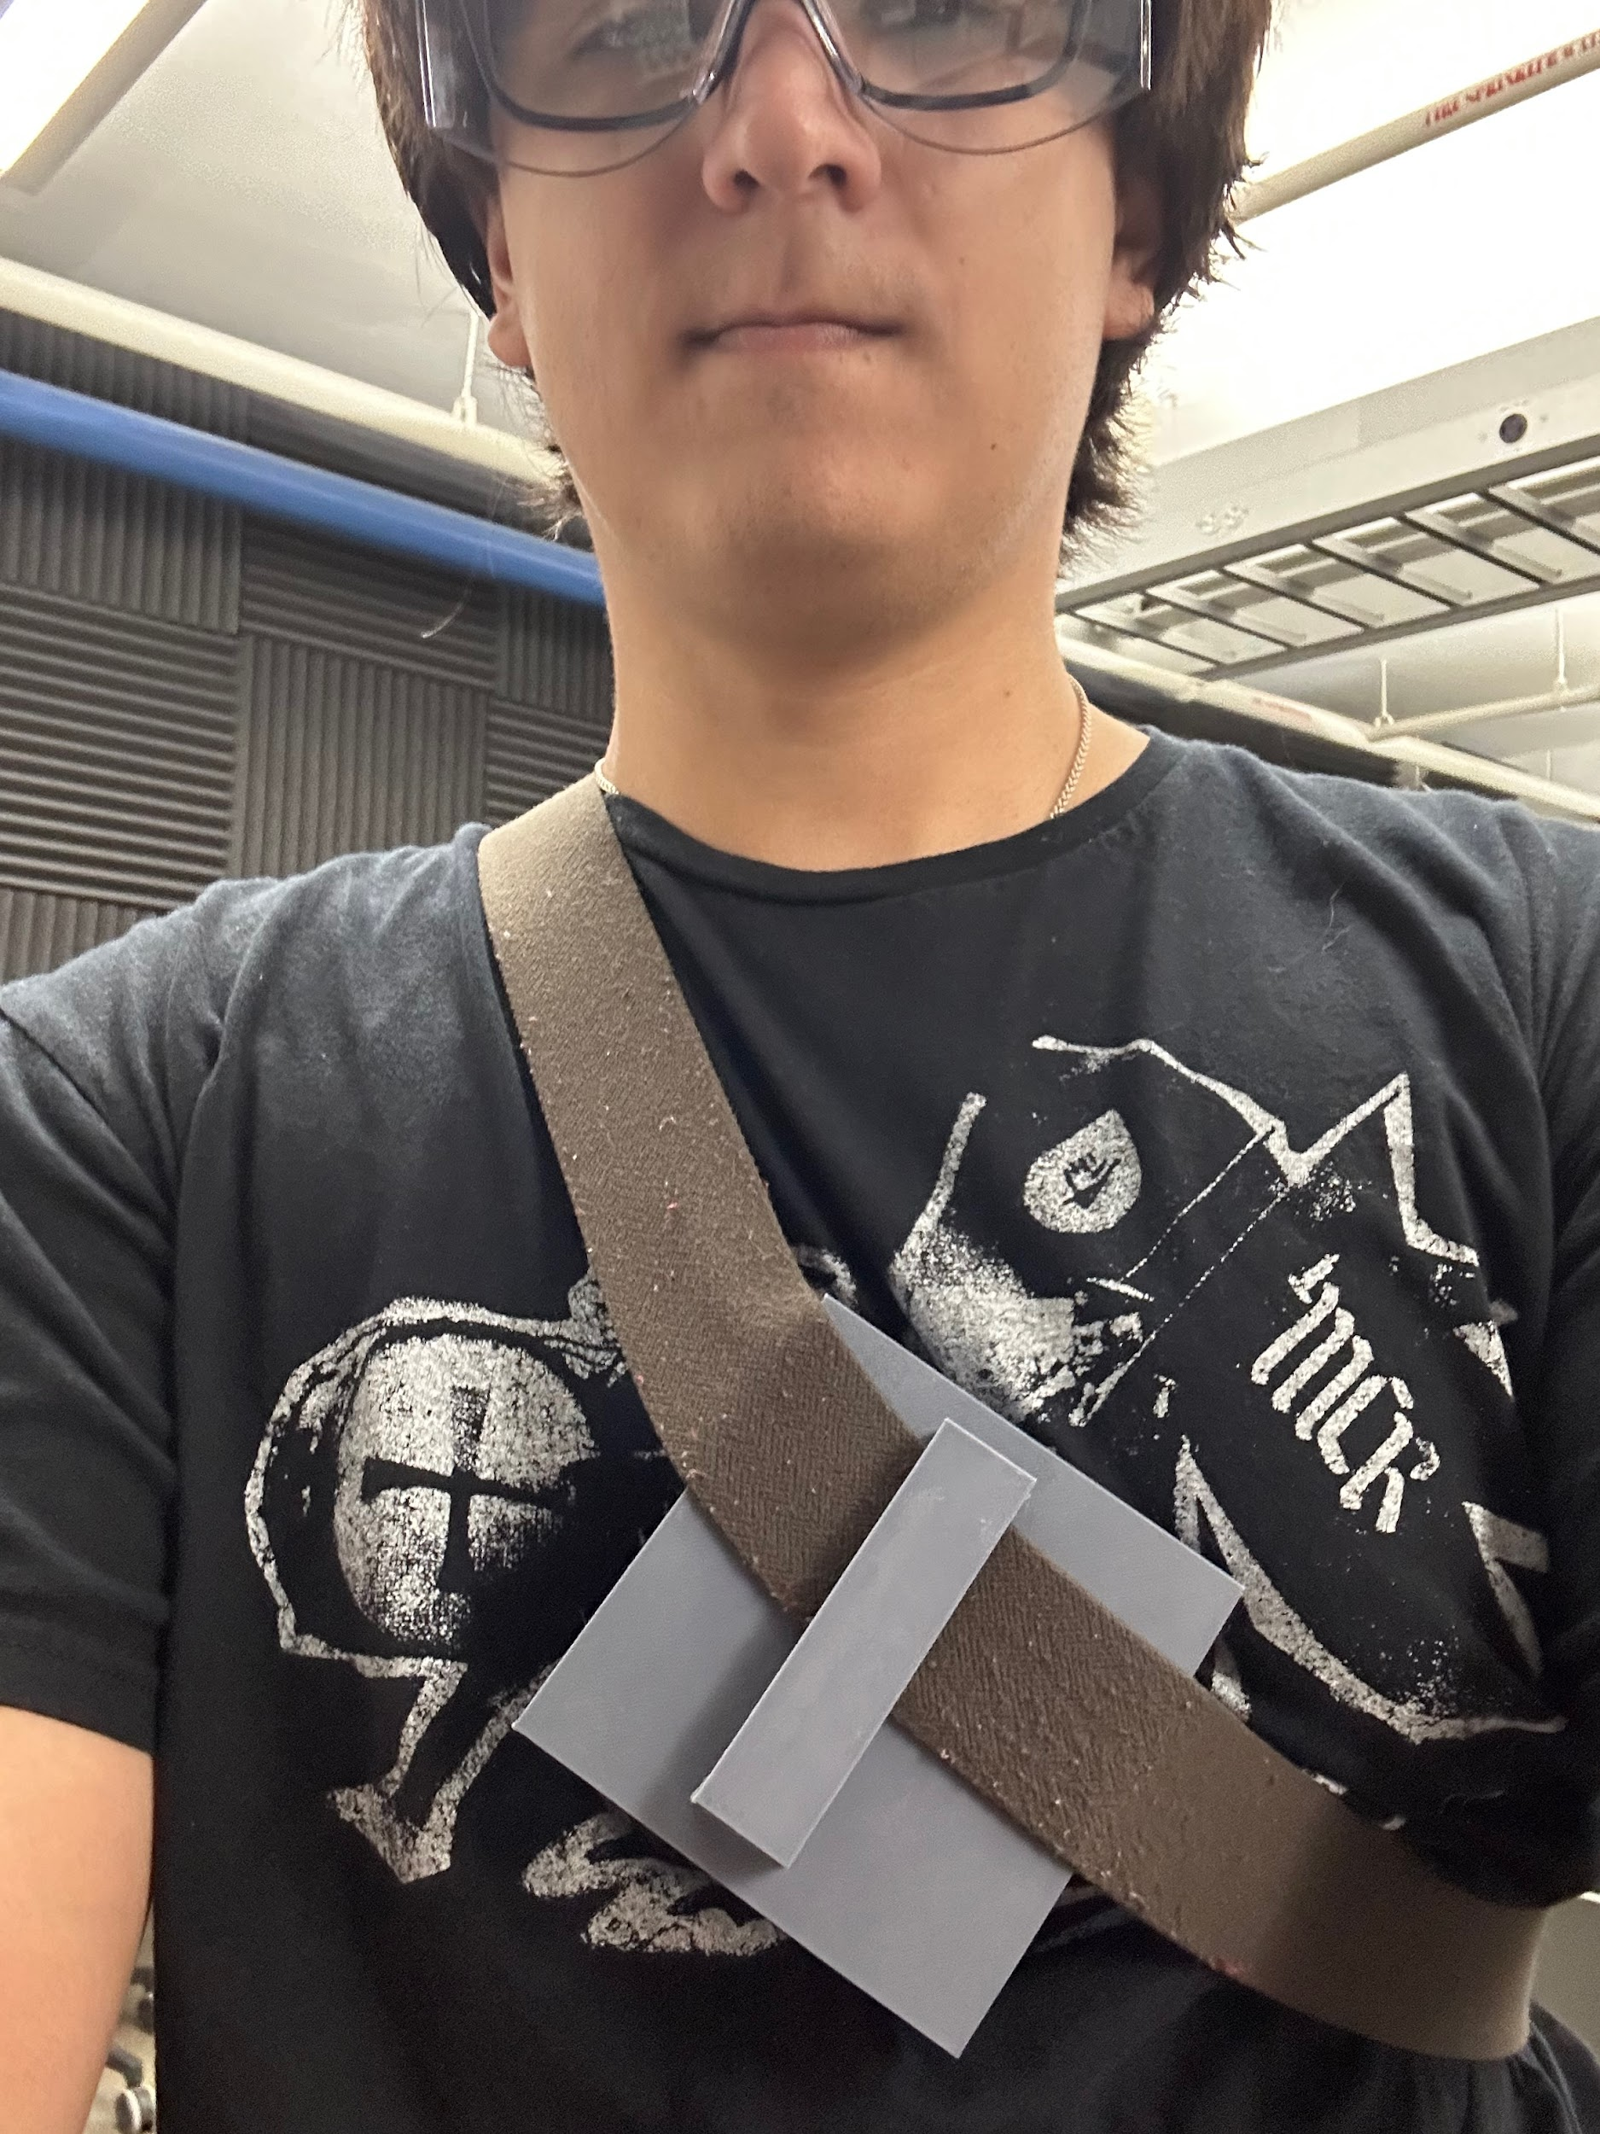
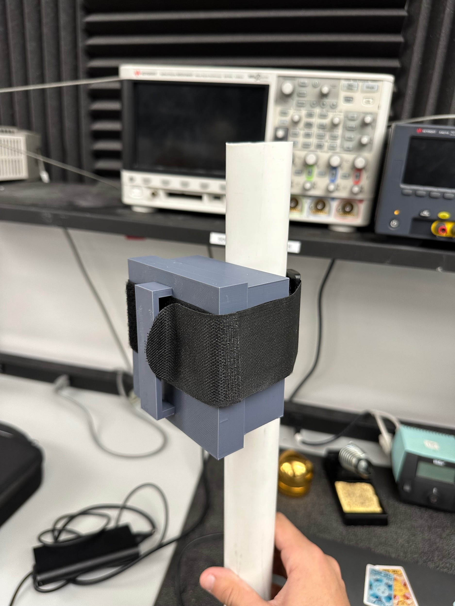
3.2.2.3 Mounting Validation
Receiver was mounted on a stand (PVC pipe) with a velcro strap and was shaken lightly to validate stability
Transmitter was worn by an individual with a strap across their body to validate stability and comfortability

Slide 9
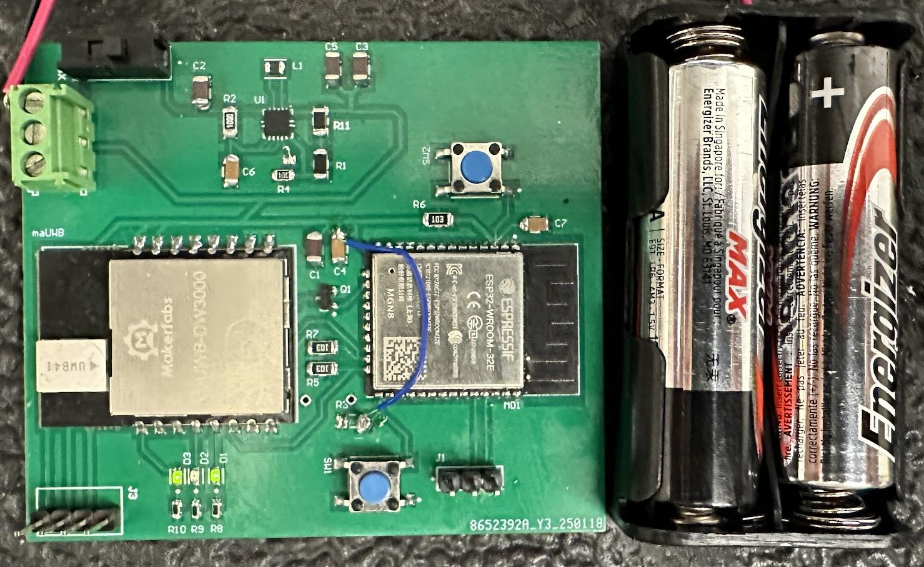
3.2.3.1.1 Power Consumption Validation
With a current draw of approximately 315 mAh (240 for high end WiFi of ESP, 75 for UWB module) and a voltage of 3.3 V, power was validated to be 1.04 Wh
Additionally, wa tested to run for approximately 5 hours of full operation

Slide 10
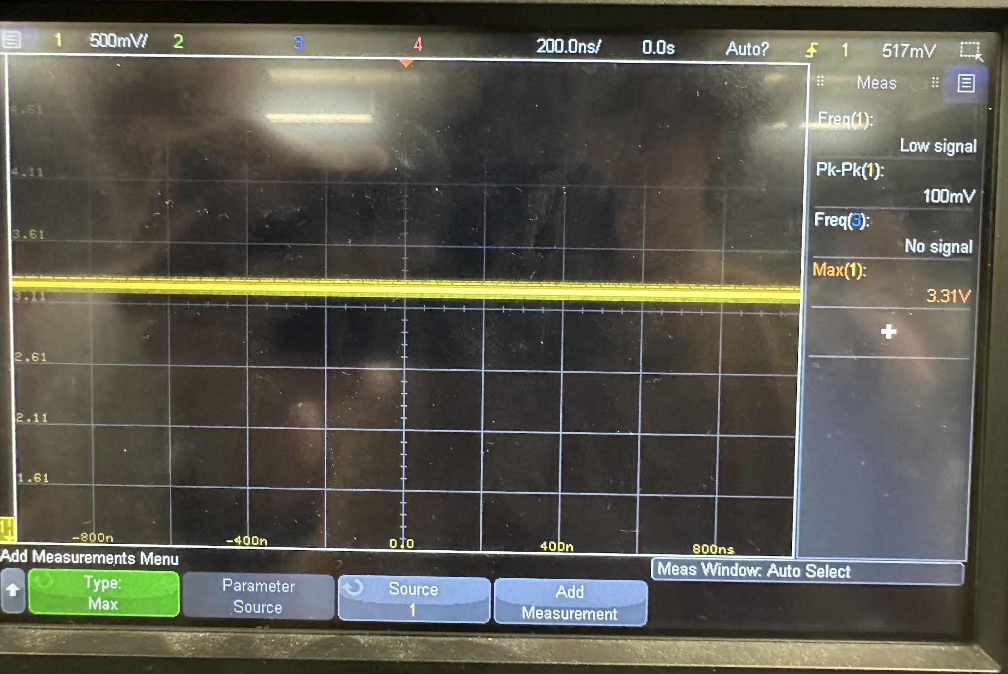
3.2.3.1.2 Input Voltage Level Validation
Input Voltage was tested over a range from 1.8 V to 3.2 V, simulating the range from two nearly dead AA batteries and two potentially overcharged
For input voltages throughout this range, 3.3 V output was recorded

Slide 11
3.2.4.2 Thermal Validation
Hardware was placed in an oven and maintained proper operations
Hardware was placed in a freezer and maintained proper operations
In the field, my iPhone overheated while my boards were just fine.

Slide 12

Full Scale Test
Video Link

